Slide 1
P4P: Provider Portal for Applications
Haiyong Xie, Y. Richard Yang, Arvind Krishnamurthy, Yanbin Liu, Avi Silberschatz
Yale University, University of Washington, IBM T.J. Watson
SigComm 2008

Slide 2
The Problem
P2P is network oblivious
  Intradomain: the network-oblivious peering strategy of many P2P applications may cause traffic to scatter and unnecessarily traverse multiple links inside a provider’s network.
  Interdomain: network-oblivious P2P may generate a significant amount of interdomain transit traffic or relay a substantial amount of traffic between the providers of a network.
Design a framework to enable better providers and applications cooperation

Slide 3



P2P Problem : Network Inefficiency
Network-oblivious P2P applications may not be network efficient
  Verizon
    Average P2P bit traverses 1000 miles
    Average P2P bit traverses 5.5 metro-hops
  Karagiannis et al. on BitTorrent, a university network (2005)
    50%-90% of existing local pieces in active users are downloaded externally
Notes:
Clearly P2P is popular and good to content owners. However, from the network’s perspective, P2P is a problem. One key problem is network inefficiency.

Slide 4
P2P Problem: Inefficient Interactions
  ISP: traffic engineering to change routing to shift traffic away from highly utilized links
    Current traffic pattern ➔ new routing
  Adaptive P2P: direct traffic to better performing peers
    Current routing matrix ➔ new traffic pattern
There exists inefficient Nash equilibrium point

Slide 5
Approaches
P4P architecture:
  Control plane (focus of the paper)
  Management plane (monitor the behavior of control plane)
  Data plane (optional, for prioritizing traffics)

Slide 6
The P4P Framework: Control Plane
iTracker: a portal for each network resource provider (should have called iPortal)
An iTracker provides multiple interfaces
  Each provider decides the interfaces it provides
  Each interface is encoded in Web Service Definition Language (WSDL) for extensibility
iTracker of a provider can be identified in multiple ways
  e.g., through DNS SRV records; whois
  iTracker can be run by trusted third parties
iTracker access protected by access control

Slide 7
Example Interfaces
Static topology/policy interface
  Connectivity
  Traffic balance ratio for inter-AS peering links, time of day preference
Provider capabilities interface
  P2P requests QoS, CoS
  Cache/ISP server discovery and participation as special clients
    To allow better hybrid integration
Notes:
Session independent
Session dependent
Rendezvous Points

Slide 8
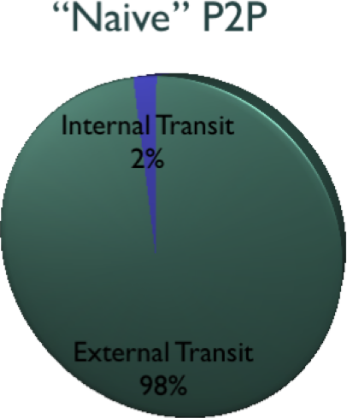
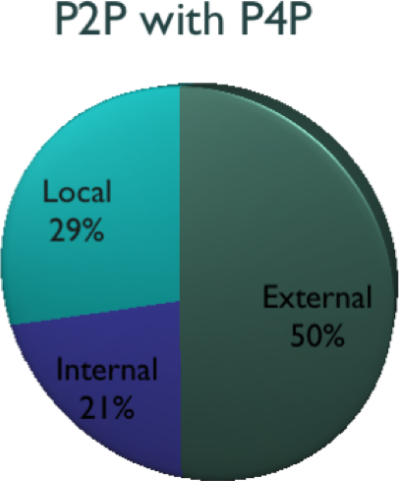
Results
FTTP 209% faster
Non-FTTP 20% faster

